Slide 1
Software Verification Validation and Testing
Presented by : Neha Tripathi

Slide 2
Software Testing preliminaries
Psychology of Software testing
Software testing definitions
Effective vs Exhaustive software testing
Effective testing is hard
Software testing as a process

Slide 3
Psychology of Software Testing
Software testing is directly related to human psychology. Though software testing has not been defined till now, but most frequently, it is defined as,
Testing is the process of demonstrating that there are no errors.
The purpose of testing is to show that the software performs its intended functions correctly. This definition is correct, but partially. If testing is performed keeping this goal in mind, then we cannot achieve the desired goals
Testing approach is based on the human psychology that human beings tend to work according to the goals fixed in their minds. If we have a preconceived assumption that the software is error-free, then consequently, we will design the test cases to show that all the modules run smoothly. But it may hide some bugs. On the other hand, if our goal is to demonstrate that a program has errors, then we will design test cases having a higher probability to uncover bugs.

Slide 4
Thus, software testing may be defined as,
Testing is the process of executing a program with the intent of finding errors.
According to this psychology of testing, a successful test is that which finds errors. This can be understood with the analogy of medical diagnostics of a patient. If the laboratory tests do not locate the problem, then it cannot be regarded as a successful test. On the other hand, if the laboratory test determines the disease, then the doctor can start an appropriate treatment. Thus, in the destructive approach of software testing, the definitions of successful and unsuccessful testing should also be modified.

Slide 5
Software testing definitions
Testing is the process of executing a program with the intent of finding errors.
A successful test is one that uncovers an as-yet-undiscovered error.
Testing can show the presence of bugs but never their absence.
Software testing is a process that detects important bugs with the objective of having better quality software.
etc.

Slide 6
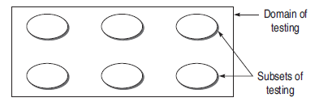
Effective vs Exhaustive software testing
Exhaustive or complete software testing means that every statement in the program and every possible path combination with every possible combination of data must be executed.
Effective testing emphasizes efficient techniques to test the software so that important features will be tested within the constrained resources.
The testing process should be understood as a domain of possible tests .There are subsets of these possible tests. But the domain of possible tests becomes infinite, as processing resources and time are not sufficient for performing these tests.

Slide 7
Why complete testing is not possible
The Domain of Possible Inputs to the Software is too Large to Test
There are too Many Possible Paths Through the Program to Test
Every Design Error Cannot be Found

Slide 8
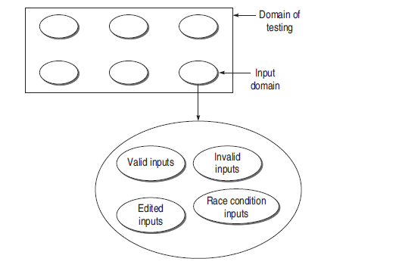
The Domain of Possible Inputs to the Software is too Large to Test
Fig. Input domain for testing

Slide 9
The domain of input data has four sub-parts:
valid inputs:
invalid inputs
edited inputs
race condition inputs

Slide 10
Valid inputs It seems that we can test every valid input on the software. But look at a very simple example of adding two-digit two numbers. Their range is from –99 to 99 (total 199). So the total number of test case combinations will be 199 × 199 = 39601. Further, if we increase the range from two digits to four-digits, then the number of test cases will be 399,960,001.
Invalid inputs Testing the software with valid inputs is only one part of the input sub-domain. There is another part, invalid inputs, which must be tested for testing the software effectively. The important thing in this case is the behavior of the program as to how it responds when a user feeds invalid inputs. The set of invalid inputs is also too large to test. If we consider again the example of adding two numbers, then the following possibilities may occur from invalid inputs:
(i) Numbers out of range
(ii) Combination of alphabets and digits
(iii) Combination of all alphabets
(iv) Combination of control characters
(v) Combination of any other key on the keyboard

Slide 11
Edited inputs If we can edit inputs at the time of providing inputs to the program, then many unexpected input events may occur. For example, you can add many spaces in the input, which are not visible to the user. It can be a reason for non-functioning of the program. The behavior of users cannot be judged. They can behave in a number of ways, causing defect in testing a program. That is why edited inputs are also not tested completely.
Race condition inputs The timing variation between two or more inputs is also one of the issues that limit the testing. For example, there are two input events, A and B. According to the design, A precedes B in most of the cases. But, B can also come first in rare and restricted conditions. This is the race condition, whenever B precedes A. Usually the program fails due to race conditions, as the possibility of preceding B in restricted condition has not been taken care, resulting in a race condition bug.

Slide 12
There are too Many Possible Paths Through the Program to Test
A program path can be traced through the code from the start of a program to its termination. Two paths differ if the program executes different statements in each, or executes the same statements but in different order. A testing person thinks that if all the possible paths of control flow through the program are executed, then possibly the program can be said to be completely tested. However, there are two flaws in this statement.
The number of unique logic paths through a program is too large(refer next fig.).
The complete path testing, if performed somehow, does not guarantee that there will not be errors.

Slide 13
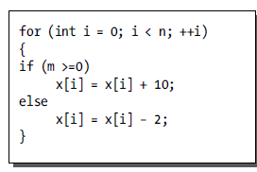
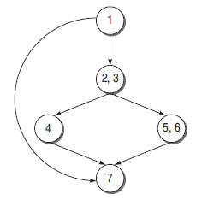
Example
Sample code fragment
flow graph

Slide 14
Every Design Error Cannot be Found
‘We can never be sure that the specifications are correct.’ Therefore, specification errors are one of the major reasons that make the design of the software faulty. If the user requirement is to have measurement units in inches and the specification says that these are in meters, then the design will also be in meters.
Secondly, many user interface failures are also design errors.
Note: The study of these limitations of testing shows that the domain of testing is infinite and testing the whole domain is just impractical. So, we shift our attention from exhaustive testing to effective testing. Effective testing provides the flexibility to select only the subsets of the domain of testing based on project priority such that the chances of failure in a particular environment is minimized.

Slide 15
Effective testing is hard
We have seen the limitations of exhaustive software testing which makes it nearly impossible to achieve. Effective testing, though not impossible, is hard to implement:
Defects are hard to find
When are we done with testing

Slide 16
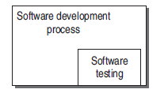
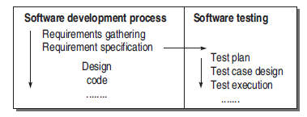
Software testing as a process
Testing process emerged out of development process
Testing process runs parallel to software process

Slide 17
An organization, to ensure better quality software, must adopt a testing process and consider the following points:
Testing process should be organized such that there is enough time for important and critical features of the software.
Testing techniques should be adopted such that these techniques detect maximum bugs.
Quality factors should be quantified so that there is a clear understanding in running the testing process. In other words, the process should be driven by quantified quality goals. In this way, the process can be monitored and measured.
Testing procedures and steps must be defined and documented.
There must be scope for continuous process improvement.

Slide 18
Thank you!

